Slide 1
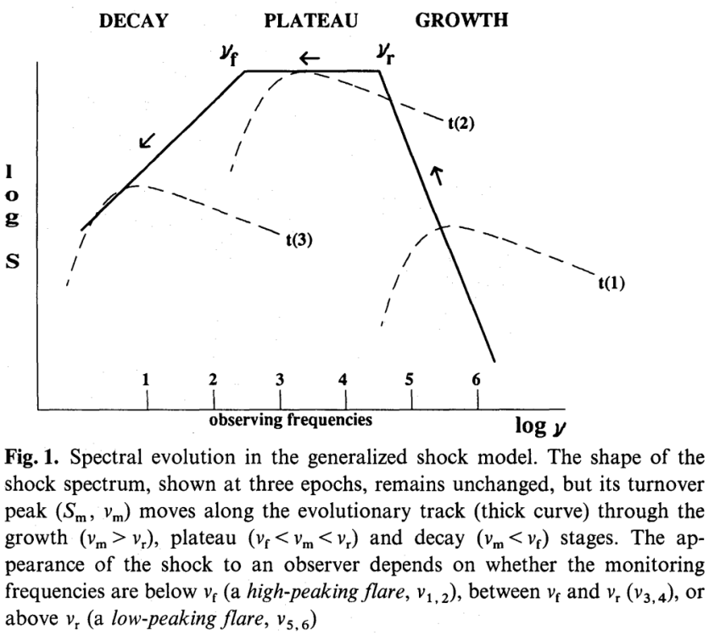
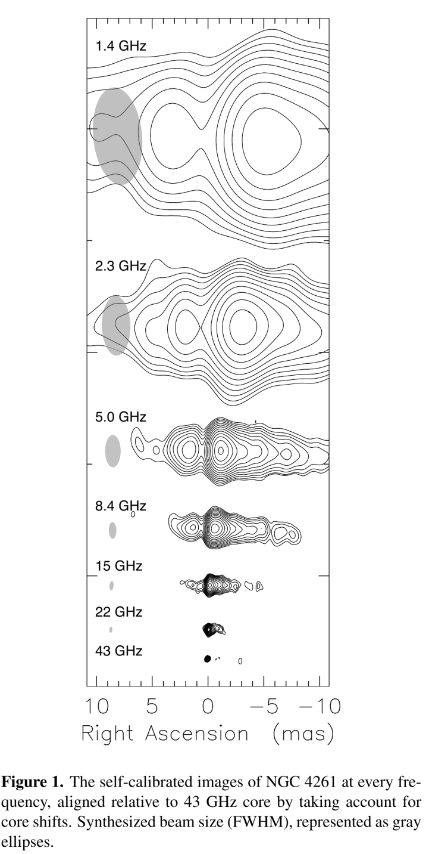
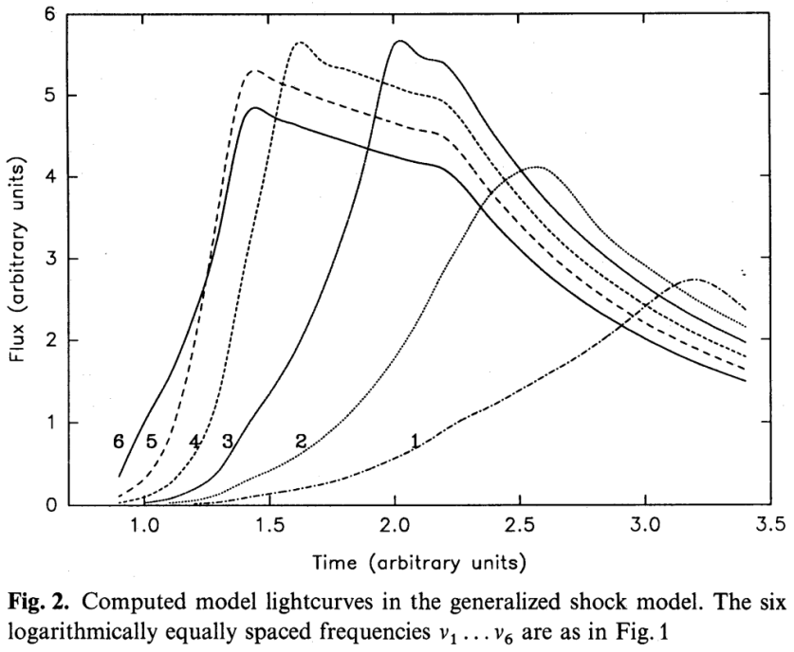
Flare peak analysis v.s. core shift ： The same optical thickness transition surface?
Flare peak analysis
Core shift method
So, after reading some papers, I started pondering on a question：Core shift measurements measured the shift of the optically surface along the jet; time delay analysis assuming the generalized shock model also assumes that the peak of a particular frequency is due it being the turnover frequency (i.e. at the transition to being optically thin/thick).
If we compare two types of measurements of the same source, do we get similar results for these two methods?
$$S_{m}\sim ν^{−0.2}$$
$$S_{m}\sim ν^{2.5}$$
Valtaoja, A&A, 254, 71 (1992)
Haga+, EPJWC, 61, 08004 (2013)

Slide 2
Flare peak analysis v.s. core shift：Two cases –PKS 1510-089；3C 279
 |  |  | core shift Pushkarev, A&A, 545, A113 (2012) |  | Flare peak analysis Orienti, MNRAS, 428, 2418 (2013) Larionov, A&A, 492, 389 (2008)
Source | pc/mas | $$β_{app}$$ | $Δr_{15−8GHz}$ (mas) | $Δr_{15−8GHz}$ (pc) | $$Δt_{15−8GHz}$$ (days) | $$Δr_{15−8GHz}$$ (pc)
1510-089 | 5 | 20.14 | 0.151 mas | 0.756 | 35 | 0.593
3C 279 | 6.31 | 20.57 | <0.051 mas | <0.32 | 10 | 0.172
For these two sources, the consistency seems to be quite well. Therefore, I guess that it is the case for sources which have very small inclination angles to have this property of flare peak analysis giving the same result as core shifts.
Orienti, MNRAS, 428, 2418 (2013)
35days
As for M87, this is definitely not the case when we discuss the HST-1 region! The core shift for M87 is around 10~100 Rs whereas HST-1 is >${10}^{5}$ Rs downstream!

Slide 3
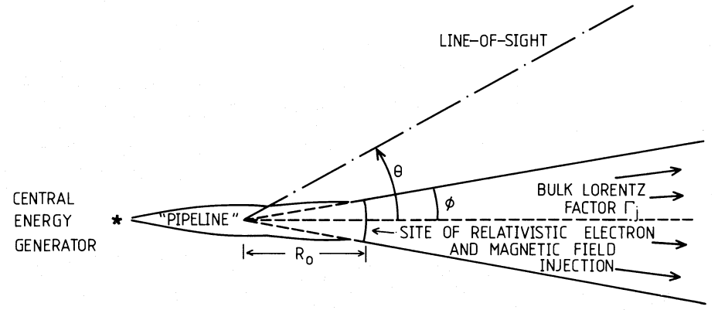
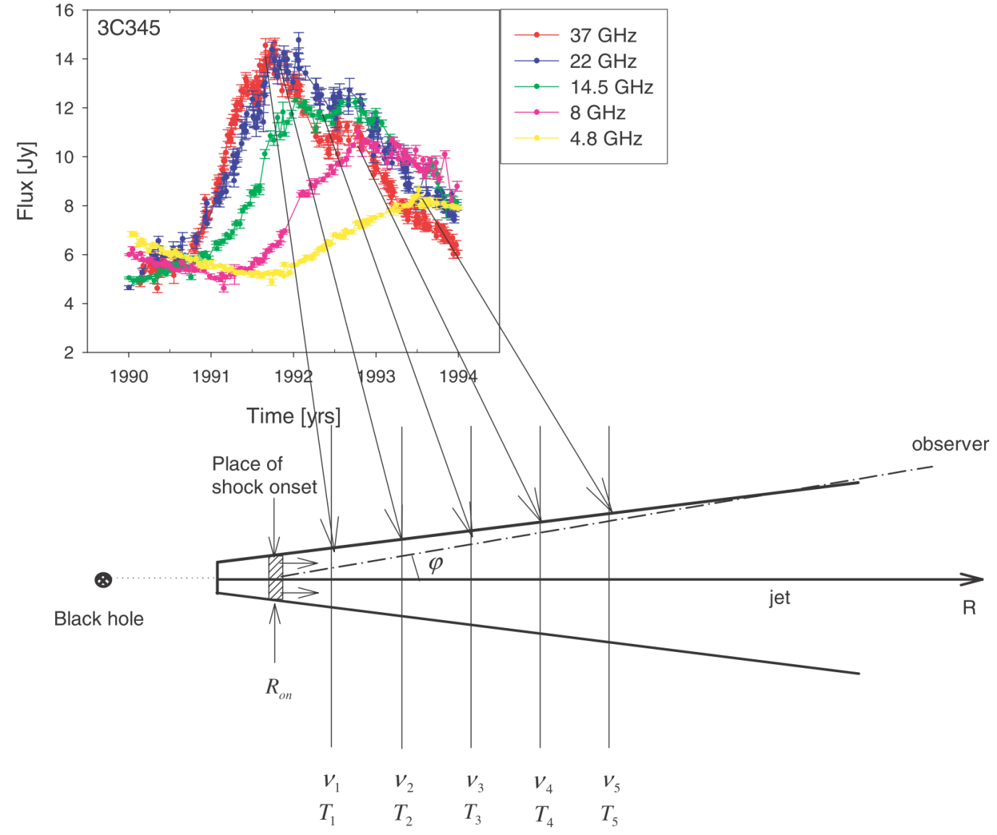
Sort of exciting when you find out that you understood something quite fundamental, but quite disappointing when you find that someone has already published something…
Proposed core-shift complement
Shock model Marscher&Gear 1985
Marscher & Gear 1985, ApJ, 298, 114 (1985)
Generalized Shock model
(for fitting observations)
Kudryavtseva, MNRAS, 415, 1631 (2011)
Valtaoja, A&A, 254, 71 (1992)

Slide 4
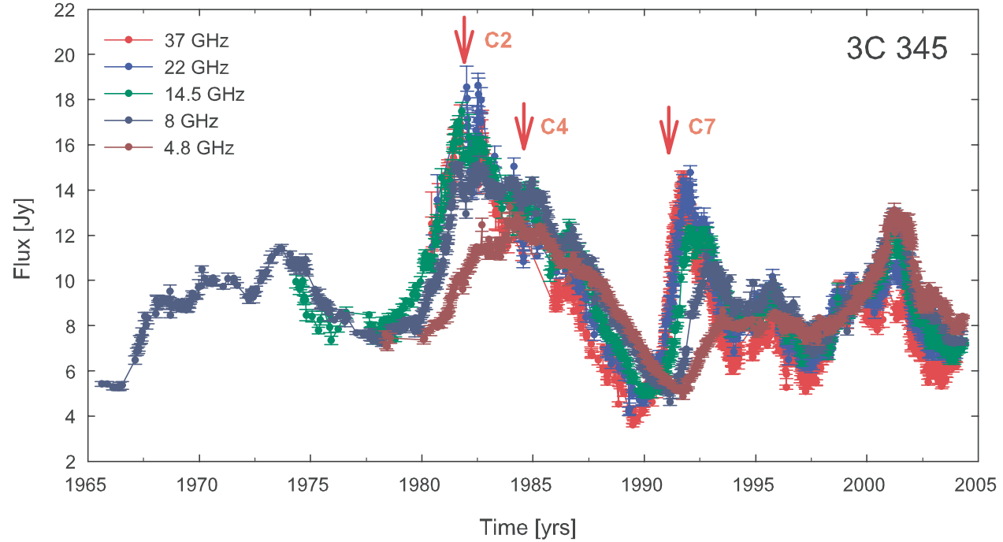
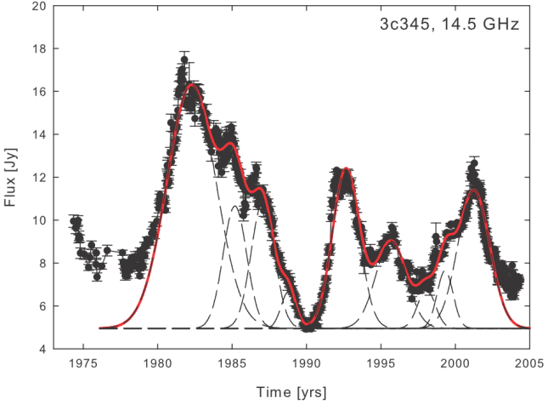
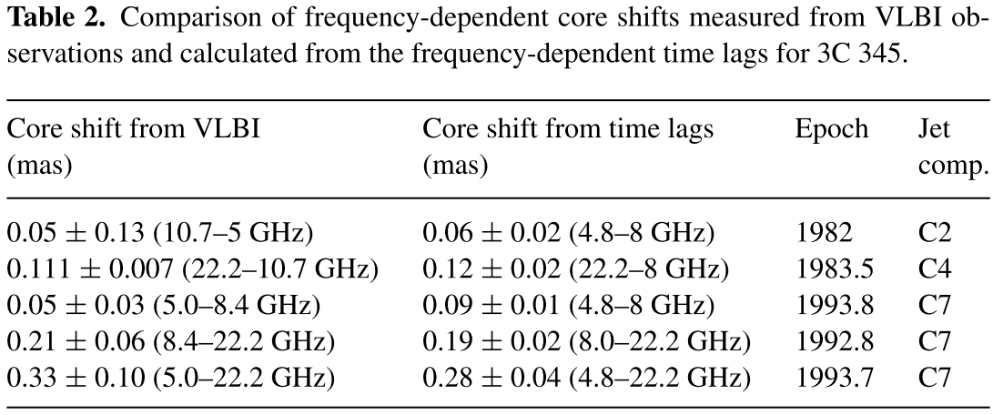
Comparison of the two methods for different flares and different components！
Kudryavtseva, MNRAS, 415, 1631 (2011)

Slide 5
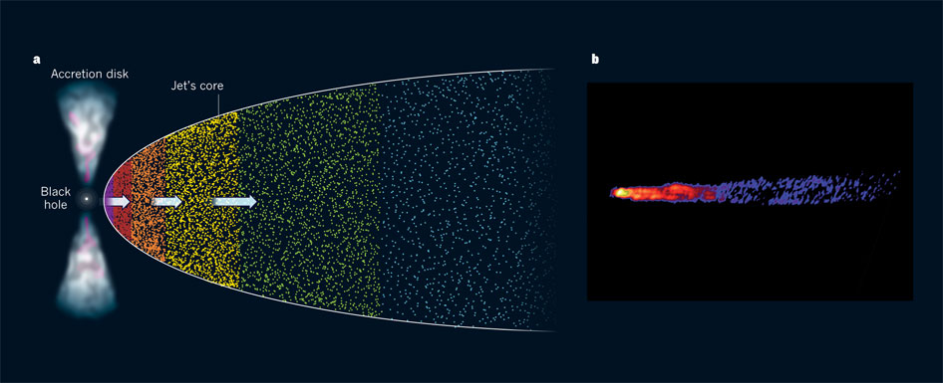
The BIG question：When does this break down？
It all looks great but as pointed out in Marscher, Nature, 477, 164 (2011)：
Hada+ 2011 have found that the core at 43 GHz is located only 14 to 23 Schwarzschild radii from the black hole. This value is surprisingly small, because estimates of the black-hole-to-core distance in quasars, which are more-luminous cousins of M87, are more than 100,000 times the Schwarzschild radius.
How are we to reconcile the short black-hole-to-core distance of M87 with the much longer distance inferred in some quasars?

Slide 6
Thesis topic anyone？
How are we to reconcile the short black-hole-to-core distance of M87 with the much longer distance inferred in some quasars?
Perhaps jets spread out more rapidly in lower-luminosity objects because there is less hot ionized gas in the nucleus to confine the flow. Another possibility is that the jet consists of an ultra-fast (99% of the speed of light) spine surrounded by a slower (perhaps 90% of the speed of light) sheath. In quasars with bright jets, the spine points almost right at us, so we see the radiation beamed in our direction, whereas emission from the sheath is too weak to be noticed. The jet of M87 is more inclined to our line of sight, by 15–25°, so the spine is relatively dim, allowing us to see the slower sheath. The images of M87 thereby reveal slower regions of the jet that are close to the black hole, whereas in quasars the jets become bright only where the spines reach their terminal velocity at much greater distances from the black holes.
My proposal：
Perhaps there will be some angle by which the core shift abruptly changes？
Maybe we could use the differences between the core shift and flare peak analysis to find out some ‘critical angle’ in which we go from seeing the spine to seeing the sheath.

Slide 7
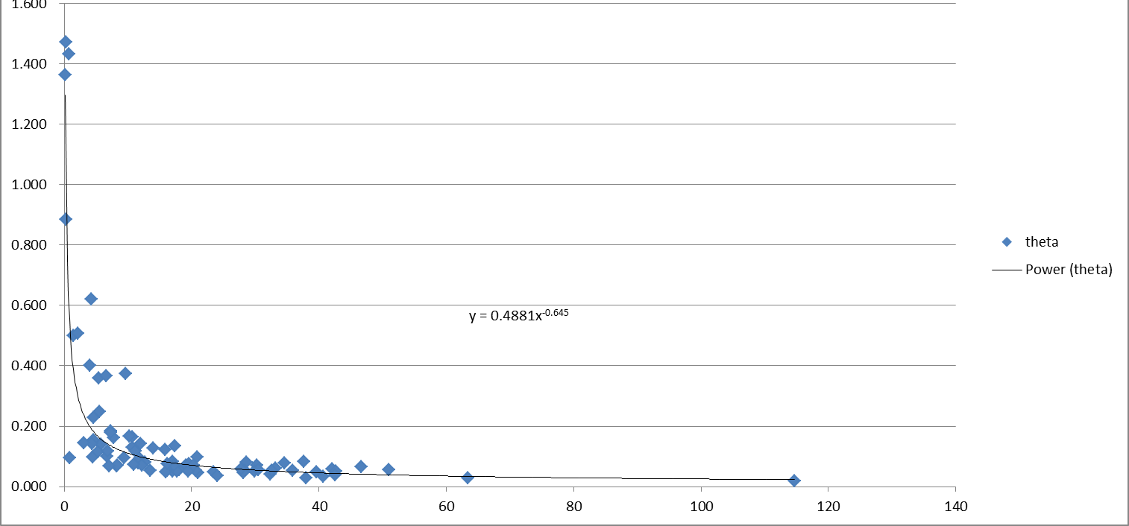
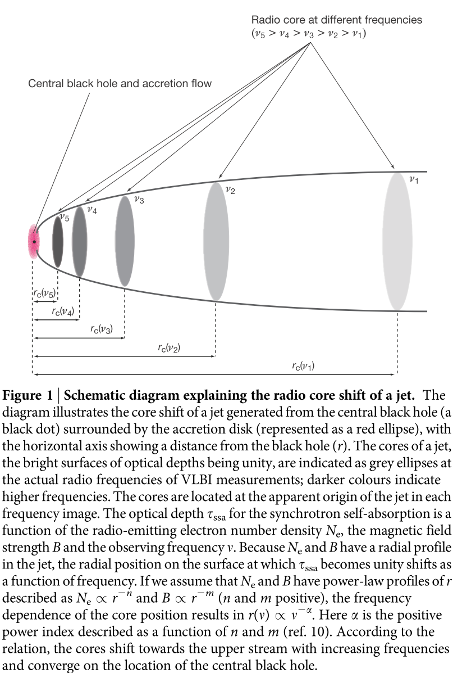
In the MOJAVE paper, they estimate the distance of the ‘true’ core (whatever that may mean…) to the 15GHz ‘core’.
I made a quick plot of the estimated viewing angle versus the 15GHz core (optically thin surface)… and it looks like this:
OK, don’t ask me what it means… it only says that the angle seems to affect how thick the region we are looking at is… (as Mizuno suggested to me in a previous discussion…)
Hada+, Nature, 477, 185
15GHz

Slide 8
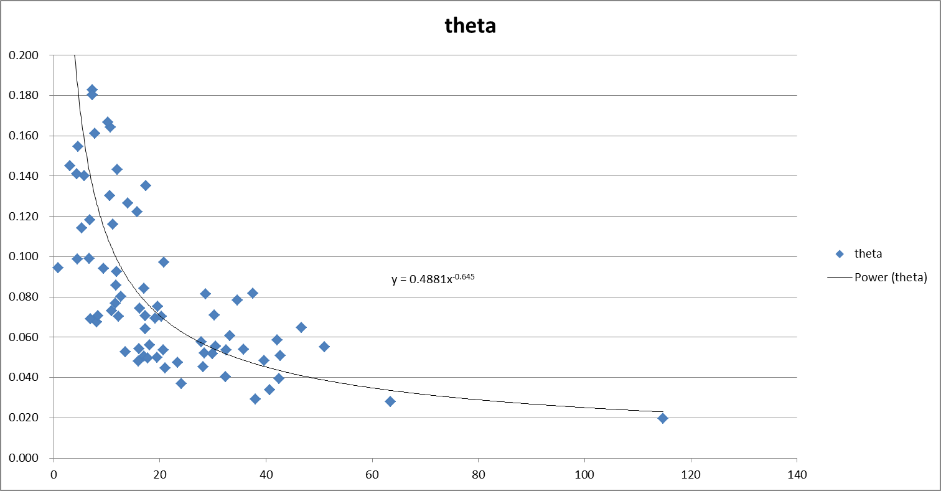
So what I was wondering is that :
If there indeed is a difference between seeing the spine or sheath, then would there be some abrupt change at some angle? (maybe >10 degrees?)
One more thesis topic (?)
Hada+, Nature, 477, 185
15GHz

